Slide 1
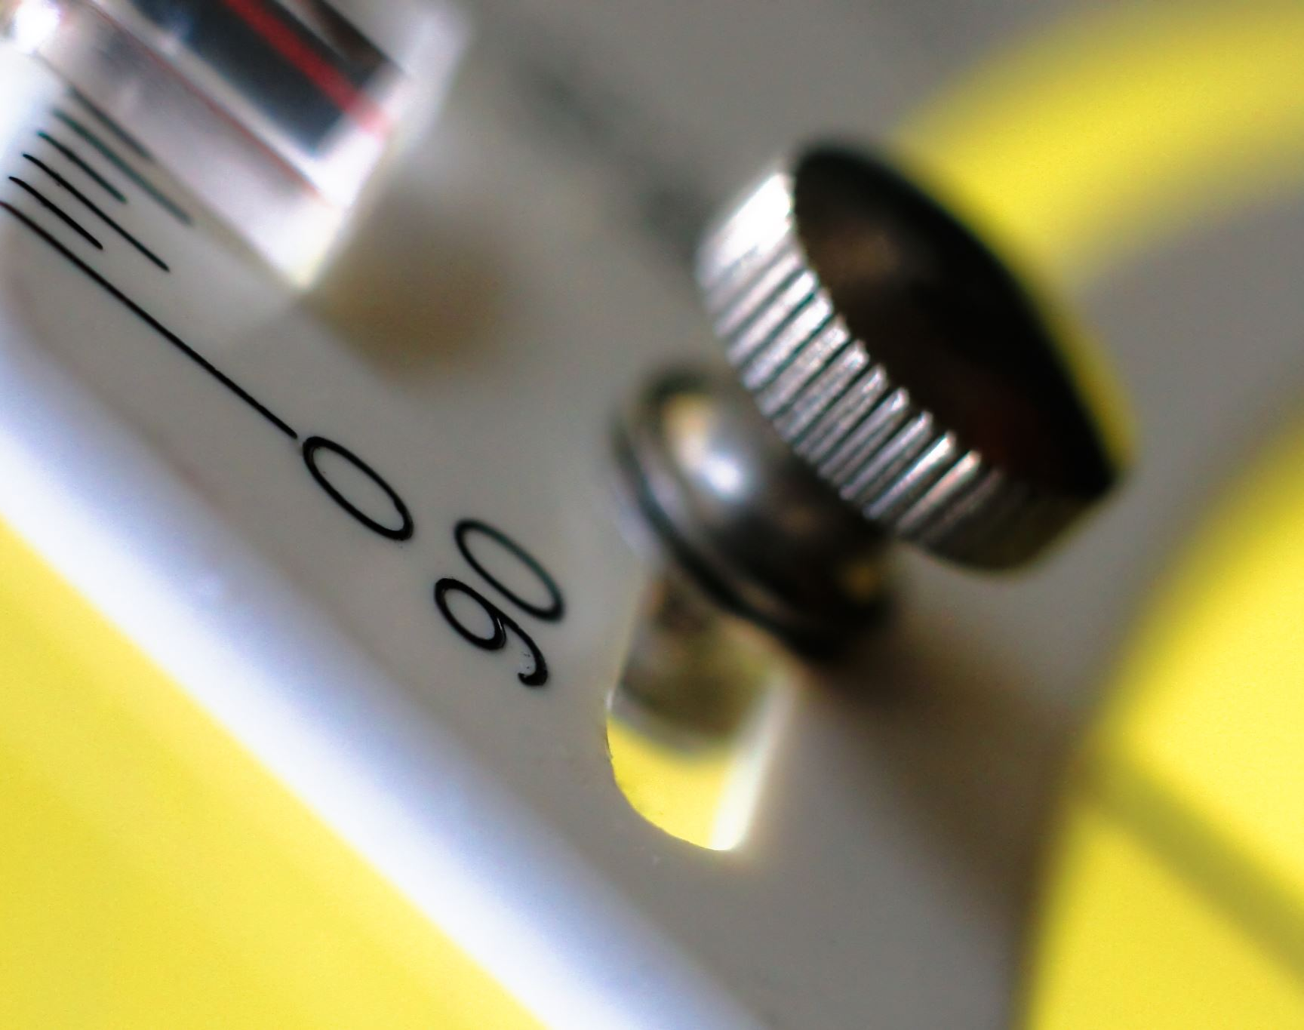
Water level tank control system
Girija Jyothi Golla (541761)
2023-24

Slide 2
Hypothetical Scenario Overview
Consider a hypothetical water tank level control system, which keeps the water level in the tank within a particular range through automated control action. The setup will include a Programmable Logic Controller that will provide automation to fill the water tank, and an HMI for user interaction with the control system. The scenario is as follows: It means that the water tank should always be operated within a safe range through continuous monitoring and control. The system switches the pump on when the water level reaches below a minimum value and turns it off when the tank is full to avoid any overflow It may also be controlled manually after the operator commands either the starting of the pump or its stoppage accordingly, Major Components and Assumptions Sensors (Simulated): There are no physical sensors; thus, the case uses low and high-level simulated indications for respective water levels. Pump Control Logic: The pump draws its control logic from water level inputs in which, at low, it turns the pump on and when full, it turns it off. Scaling and Limits: PLC raw values are scaled up to readable percentage value, that is, 0 – 100%, for user-friendly perceptions of the level of the tank. The limits are set to 0% and 100% for low and high, respectively. HMI Interface: A graphical HMI serves as the user interface, which visually shows the tank, pump status, and water levels in an easily understandable and interactive format.

Slide 3
Possible Solution Analysis
1. Control Logic Automated Pump Activation: The level indicators thus enable the system to automatically activate pumps efficiently. This is simple on/off control logic that has proved highly adequate to make sure the pump operates only when it needs to, hence conserving energy and preventing overflows. Manual Control Option: By providing a manual start/stop, flexibility is brought into the system to allow overriding of the automatic logic. 2. Use of Memory Bits On/Off State Memory: Using memory bits to handle the on/off state for the pump allows the PLC to remember the state of the pump in case of a momentary power outage or manual override. 3. Sensor Simulation and Scaling Sensor Simulation: Using simulated indications rather than sensors facilitates the testing and troubleshooting in prototype stages easily. Scaling Block for Readability: This block converts raw PLC values into a percentage format to make the data intuitively comprehensible for operators, thereby avoiding misinterpretations. 4. Error Handling and Limits Limit Settings: The limits of the system, 0% and 100%, prescribe the safe operating envelope of the system, ensuring that the pump does not overfill or underfill the tank. Error Detection: Incorporating error checks in the scaling block can have the system support reliability by informing operators whether there are calibration or input problems. 5. User Interface Design Visual Simulation of the Tank: The visual simulation of the tank gives the operator an intuitive understanding about the state of the tank by the animated components such as sliders and pipes. HMI Layout: Clearness of the design in the HMI makes it more user-friendly, especially for users that are less technologically oriented, and contributes to enhancing usability and safety.

Slide 4
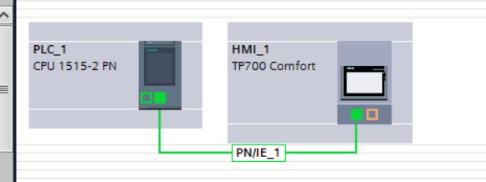
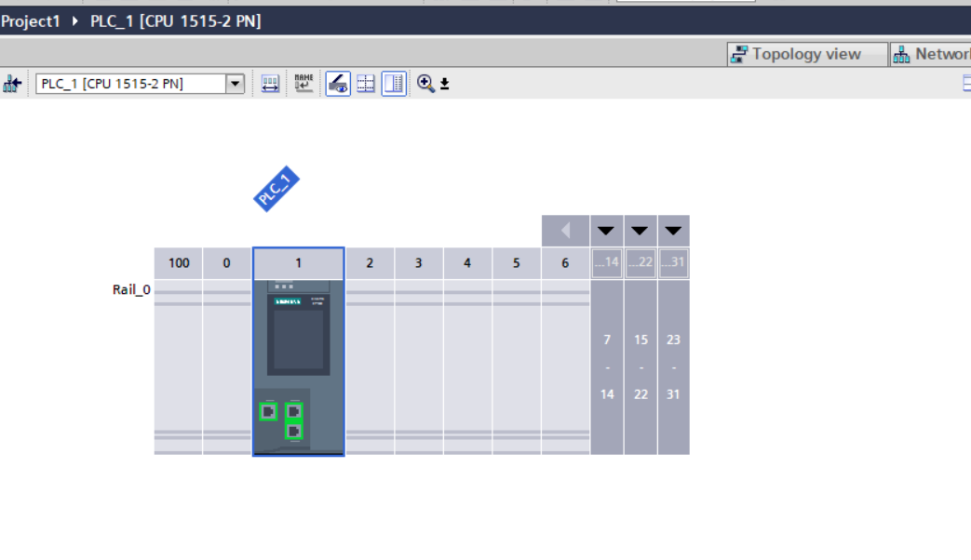
PLC Hardware Set-Up
The CPU 1515-2 PN is the CPU with a medium program and data memory for applications that also contain distributed automation structures alongside central I/O. It can be used as a PROFINET IO controller or as distributed intelligence
SIMATIC HMI TP700 Comfort, Comfort Panel, touch operation, 7" widescreen TFT display, 16 million colors, PROFINET interface, MPI/PROFIBUS DP interface, 12 MB configuration memory, Windows CE 6.0, configurable from WinCC Comfort V11

Slide 5
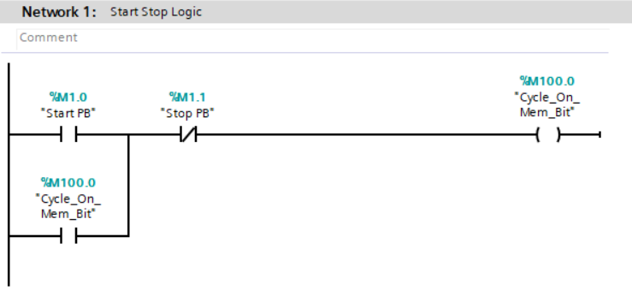
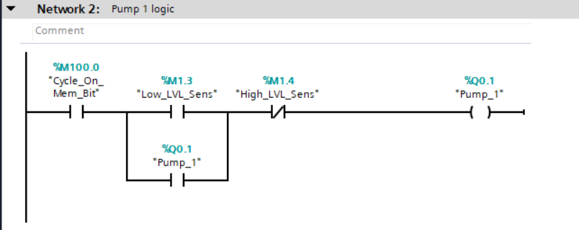
Ladder Diagrams and description

Slide 6
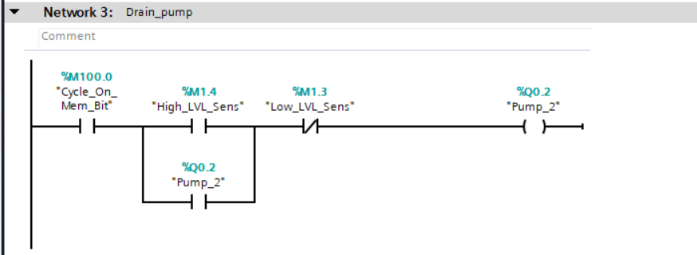
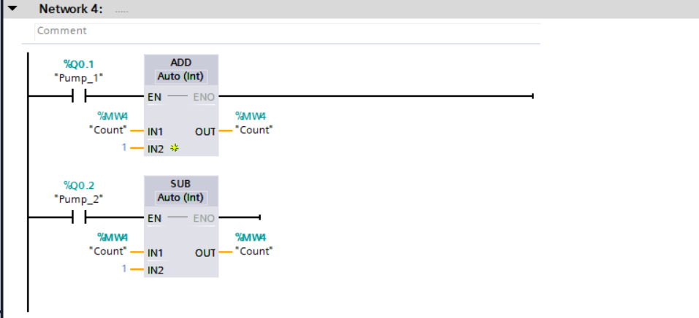

Slide 7
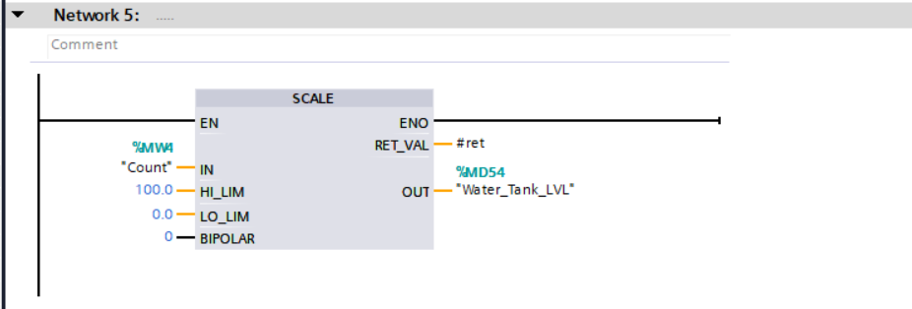
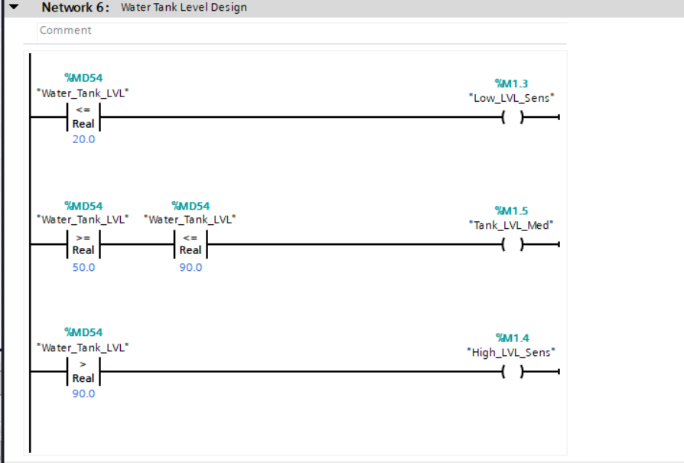

Slide 8
Description
Basic Water Tank Control Logic: This video describes how to implement basic water tank level control logic using a PLC and HMI. When the level of the water is low, the pump starts, and it automatically stops once the tank is full, which happens to be 100%.
The system contains logic with memory bits for on/off control in handling the on/off state of a pump. The logic also covers the setup for the start/stop button to manually switch the pump on until the high-level sensor triggers.
Sensor Simulation and Scaling: Since there are no physical sensors, all low and high-level indicators are simulated in this model. A scaling block is used to scale the raw PLC count values within the given range; for example, 0–25000 into percentage level values, 0–100%, that can be read by operators more intuitively.
Setting of limits and error handling: This was done by setting the high and low limits at 100 and 0% respectively, and ensuring that the bipolar option is off; this means negative values are not given. Error checks were placed in the scaling block to troubleshoot any forms of errors.
User Interface and Presentation Tips: The video presents how an HMI layout must be clear and presentable. For the presentation of tank and sensor status, it uses sliders, pipes, and animated buttons to make the interface user-friendly.

Slide 9
Conclusion
This solution has provided a simple, efficient solution to the control of water tanks using PLC and HMI. The control logic is simple, thus allowing the flexibility of automated and manual operations at the level of simulated sensors. Scaling and error handling enhance data accuracy, adding resilience to the system. In addition, an appropriate HMI design enhances ease of use, a critical aspect of any automated system operated by people with diverse technical backgrounds.

